Slide 1
A FINANCE AND INVESTMENT FRAMEWORK FOR RURAL E-COMMERCE USING DATA MINING AND BLOCKCHAIN TECHNOLOGY

Slide 2
ABSTRACT:-
Rural smart e-commerce investment and financing model based on blockchain and data mining is presented in this paper. Using intelligence analysis to prevent financial risks is not only an urgent expectation in the financial field, but also an inherent need for the development of the information science. Blockchain is a chained structure that combines data chunks in chronological order in a sequential manner and is a distributed ledger that is guaranteed by cryptology. The proposed model is simulated compared with the latest models.

Slide 3
EXSISTING SYSTEM | PROPOSED SYSTEM
These factors will also increase the complexity of the data collection. Most existing NMF-based dynamic topic model methods treat each potential topic as an independent element, and ignore the intersection of each topic and the relationship between them, thus limiting the expressive power of these models.. Hierarchical structure is the core feasible solution to overcome this defect. However, most of the general existing hierarchical topic models are static models, which cannot meet the requirements of detecting topics in the text stream. | Therefore, researchers have proposed a method to eliminate redundant blocks. Each non-leaf node optimizes the layout of its child nodes through the variation circle arrangement method. Here, each child node can have a different weight value, and the weight value reflects the area ratio of the circle corresponding to these child nodes in the circle of the node.. Each node of hierarchical data is often associated with a set of the node attributes, which can be combined according to application requirements for weight assignment or weight assignment directly by user interactively.
EXISTING ALGORITHM:- The Data Analytic Model | PROPOSED ALGORITHM:- The Data Mining with Layered Model

Slide 4
ALGORITHM DEFINITION:- | ALGORITHM DEFINITION:-
We present the analytic model that is weight assignment of each node, the layout algorithm recursively deals with the circle layout of nodes at each level in a breadth-first manner from the root node. Here, the sibling nodes of the same parent node maximize their corresponding circles within the circle of their parent node, and do not coincide with each other, so as to improve the space utilization rate as much as possible | Fixed-length block redundancy cannot be adjusted and optimized intelligently according to the content of the file itself, which makes this method very inefficient for the file insertion and deletion problems, and the effect of redundancy elimination is very poor. Therefore, researchers have proposed a method to eliminate redundant blocks. Each non-leaf node optimizes the layout of its child nodes through the variational circle arrangement method.

Slide 5
DRAWBACKS:- | ADVANTAGES:-
System can participate in the reading, writing, verification and consensus process of data. The development of Internet technology and the Internet + financial industry. Factors affecting and also restricting and also restricting financial activites have become more complex. | Can participate Development Affecting and retricting

Slide 6
MINIMUMSYSTEM REQUIREMENTS
HARDWARE REQUIREMENTS
PROCESSOR : DUAL CORE 2 DUO.
RAM : 2GB DD RAM
HARD DISK : 250 GB
SOFTWARE REQUIREMENTS
FRONT END : J2EE (JSP, SERVLET)
BACK END : MY SQL 5.5
OPERATING SYSTEM : WINDOWS 7
IDE : ECLIPSE

Slide 7
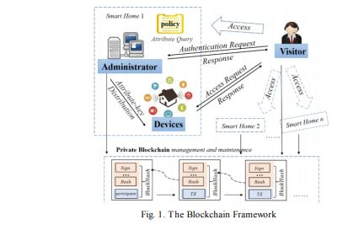
System Architecture

